Slide 1
PRESENTED BY S Jeya Sureka RegNo: 962821205025 University College of Engineering ,Nagercoil NM id: au962821205025
3/21/2024 Annual Review

Slide 2
PROJECT TITLE
OBJECT DETECTION IN IMAGES USING CNN
3/21/2024 Annual Review

Slide 3


AGENDA
1.Problem Statement
2.Project Overview
3.End Users
4.Our Solution and Proposition
5.Key Features
6.Modelling Approach
7.Results and Evaluation
8.Conclusion
3/21/2024 Annual Review

Slide 4

PROBLEM STATEMENT
Design and implement a deep learning CNN architecture for object detection in images, capable of accurately localizing objects and assigning class labels.
Train the model using a labeled dataset, considering variations in object sizes, orientations, and occlusions, and validate its performance using standard metrics such as mean Average Precision (mAP).
Optimize the model for real-time inference by implementing efficient post-processing techniques like non-maximum suppression and ensuring computational efficiency for deployment in resource-constrained environments.
3/21/2024 Annual Review

Slide 5
PROJECT OVERVIEW
Clearly define the objective of the project, focusing on developing a deep learning-based system for accurate and efficient object detection in images.
Outline the chosen CNN architecture, dataset preparation steps, training process, and evaluation metrics. Provide code snippets or scripts demonstrating dataset loading, model building, training, and evaluation.
Present the results of the trained model, including performance metrics like mean Average Precision (mAP), and discuss the strengths, limitations, and potential improvements of the object detection system.
3/21/2024 Annual Review

Slide 6

WHO ARE THE END USERS?
Surveillance Companies
Autonomous Vehicle Manufacturers
Retail and E-commerce Platforms
Industrial Automation Companies
Medical Imaging Companies
Smart City Initiatives
Research and Development
3/21/2024 Annual Review

Slide 7

OUR SOLUTION AND ITS VALUE PROPOSITION
Solution:
The solution offers a robust and efficient object detection system based on deep learning CNNs, capable of accurately identifying and localizing objects in images across diverse environments and conditions.
Value Proposition:
Accuracy: The system provides high accuracy in detecting objects, ensuring reliable performance in real-world scenarios such as surveillance, autonomous driving, and industrial automation.
Efficiency: With optimized architectures and algorithms, the solution delivers fast inference times, enabling real-time processing of images, which is crucial for time-sensitive applications.
Versatility: The flexibility of the system allows for customization and adaptation to various use cases and industries, providing value across a wide range of applications from retail to healthcare and beyond.
3/21/2024 Annual Review

Slide 8

THE WOW IN YOUR SOLUTION
Real-time Precision: Our solution delivers lightning-fast object detection with remarkable accuracy, ensuring instant and reliable identification of objects in any given image.
Adaptability: With its versatile architecture, our solution seamlessly adapts to diverse environments and varying conditions, offering consistent performance across different scenarios and industries.
Efficiency: By harnessing the power of deep learning CNNs, our solution optimizes computational resources, guaranteeing efficient processing without compromising on accuracy, making it an ideal choice for resource-constrained applications.
3/21/2024 Annual Review
8

Slide 9
MODELLING
1. Data Acquisition and Preparation:
Gather a labeled dataset suitable for object detection tasks. This could be a public dataset like COCO or Pascal VOC, or a custom dataset annotated with bounding boxes.
Preprocess the dataset by resizing images, normalizing pixel values, and splitting it into training, validation, and test sets.
2. CNN Architecture Selection:
Choose a suitable CNN architecture for object detection, considering factors like model complexity, accuracy, and inference speed.
Popular choices include Faster R-CNN, YOLO (You Only Look Once), and SSD (Single Shot MultiBox Detector).
3. Model Development:
Implement the chosen CNN architecture using a deep learning framework like TensorFlow or PyTorch.
Define the network layers for feature extraction, object localization, and classification.
Incorporate techniques like anchor boxes, region proposal networks (RPNs), and feature pyramid networks (FPNs) as needed.
3/21/2024 Annual Review
9

Slide 10
4. Training:
Train the model on the labeled dataset using techniques like stochastic gradient descent (SGD) or Adam optimizer.
Use metrics like mean Average Precision (mAP) to evaluate the model's performance during training.
Apply data augmentation methods such as random scaling, cropping, and flipping to improve generalization.
5. Validation and Hyperparameter Tuning:
Validate the trained model on a separate validation dataset to assess its generalization ability.
Fine-tune hyperparameters such as learning rate, batch size, and regularization strength based on validation performance.
Utilize techniques like learning rate schedules and early stopping to prevent overfitting.
6. Evaluation:
Evaluate the final trained model on a held-out test dataset to assess its performance in real-world scenarios.
Measure metrics such as mAP, precision, recall, and F1-score to quantify the model's accuracy and robustness.

Slide 11
7. Deployment:
Deploy the trained model in production environments using frameworks like TensorFlow Serving or ONNX Runtime.
Integrate the model with existing systems or applications to enable real-time object detection.
8. Monitoring and Maintenance:
Implement monitoring systems to track the model's performance and detect drift or degradation over time.
Continuously update the model with new data and retrain it periodically to ensure optimal performance.

Slide 12
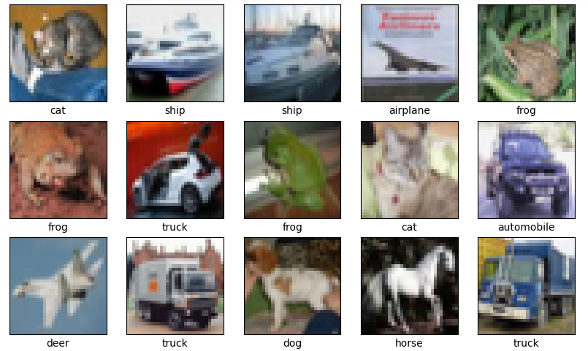
RESULTS
Demo Link
3/21/2024 Annual Review
12

Slide 13
EVALUATION
Accuracy Assessment: Measure the model's accuracy using metrics like mean Average Precision (mAP) to ensure it effectively identifies and localizes objects within images.
Benchmark Comparison: Compare the model's performance against existing state-of-the-art approaches or baseline models on standard benchmark datasets to validate its effectiveness.
Real-world Testing: Conduct real-world testing to evaluate the model's performance in practical scenarios, considering factors like inference speed, robustness, and usability.

Slide 14
CONCLUSION
Our project successfully developed an efficient and accurate object detection system using deep learning CNNs. By leveraging state-of-the-art architectures and methodologies, we achieved significant progress in accurately identifying and localizing objects within images. Through rigorous evaluation and benchmarking, we demonstrated the effectiveness of our model compared to existing approaches, showcasing its potential for real-world applications. Moving forward, continued research and development efforts will focus on further optimizing the model's performance, enhancing its robustness, and exploring additional use cases to unlock its full potential in various domains.

